Slide 1
Smoke Detection
via Assuming Linear Separability
By Banafsheh Rekabdar and Duncan Wilson

Slide 2
The Assumption: Linear Separability
The model:
The optimization problem:

Slide 3
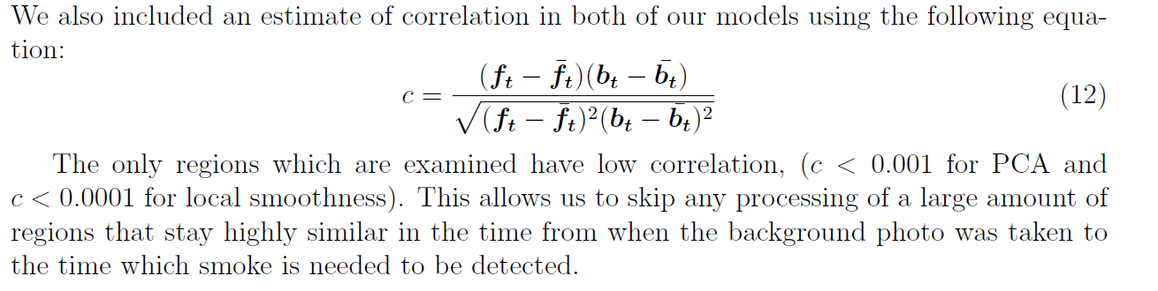
Correlation:

Slide 4
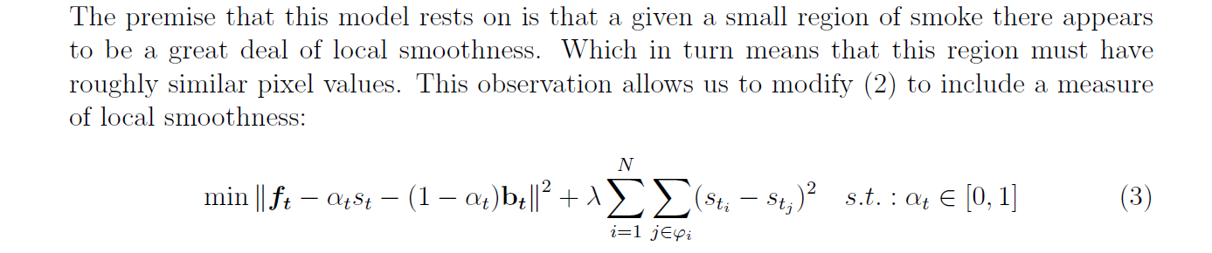

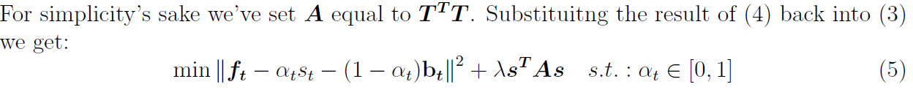
Method One: Local Smoothness

Slide 5


Solutions:
When you do the calculus you arrive at:

Slide 6
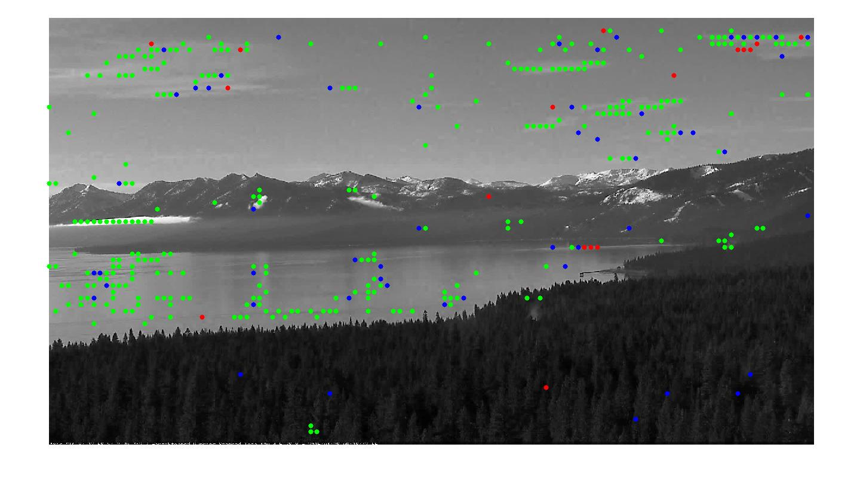
Local Smoothness Results:
A picture from the Tahoe dataset from a very early stage in two fires.

Slide 7
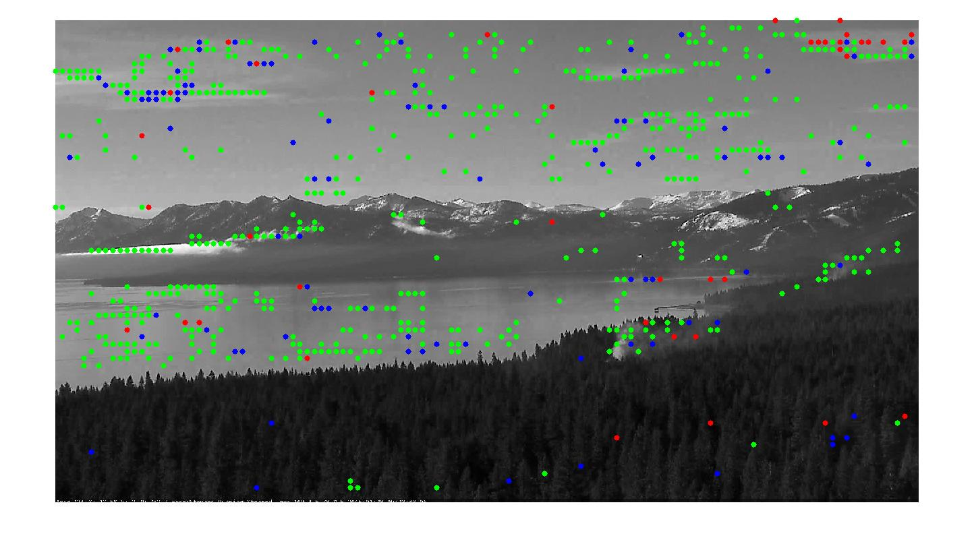
A picture from the Tahoe dataset from a later stage in the two fires.

Slide 8
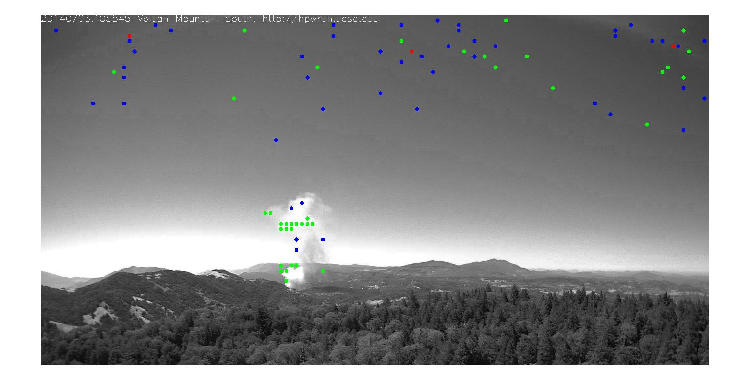
A picture from the southern California dataset, with a clear day and good region detection.

Slide 9
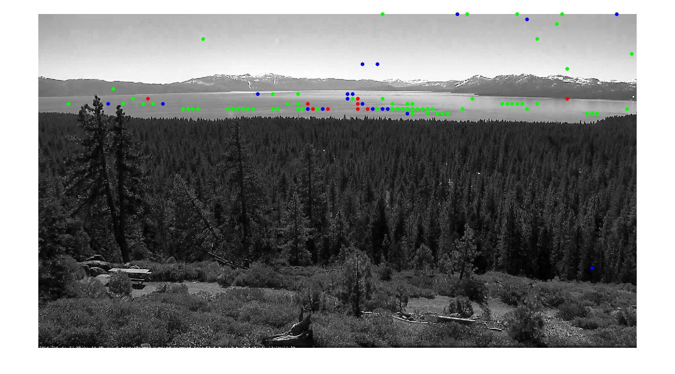
Another picture from the Tahoe dataset from a very early stage in a fire. (Doesn’t detect the region yet)

Slide 10
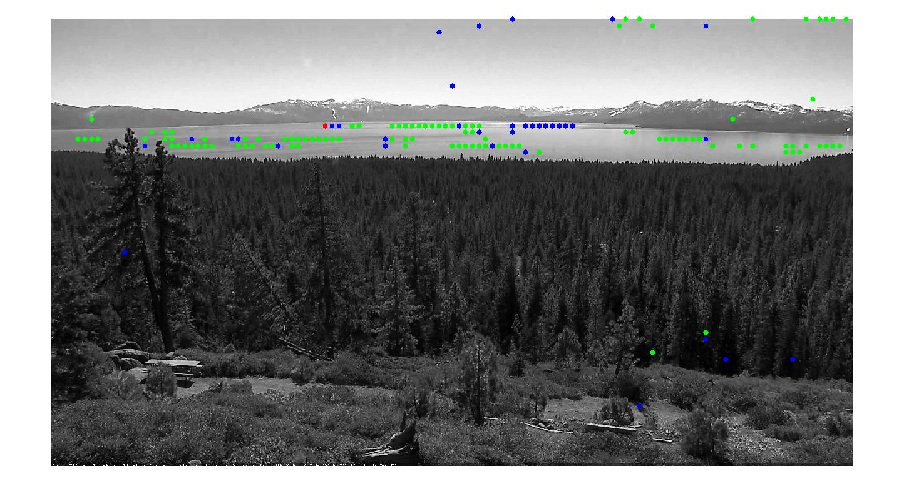
A picture from the Tahoe dataset from a later stage in the previous fire.

Slide 11
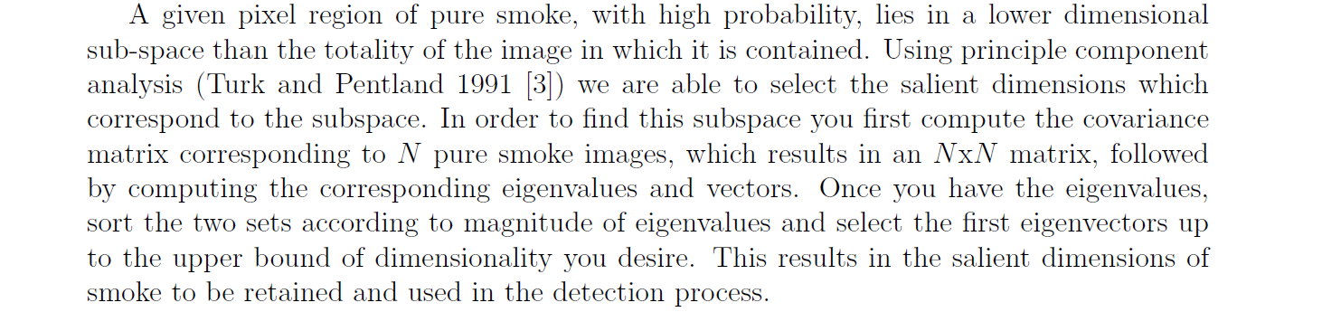
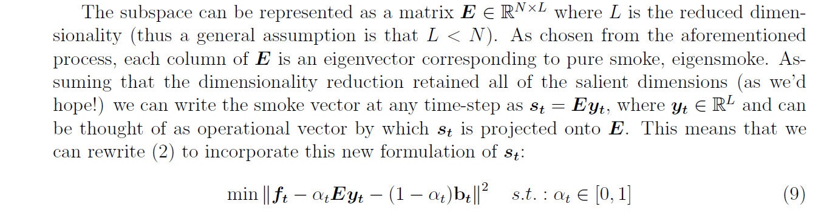
Method Two: PCA

Slide 12
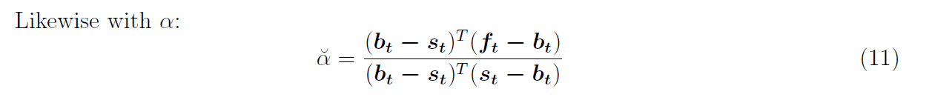
Solutions:

Slide 13
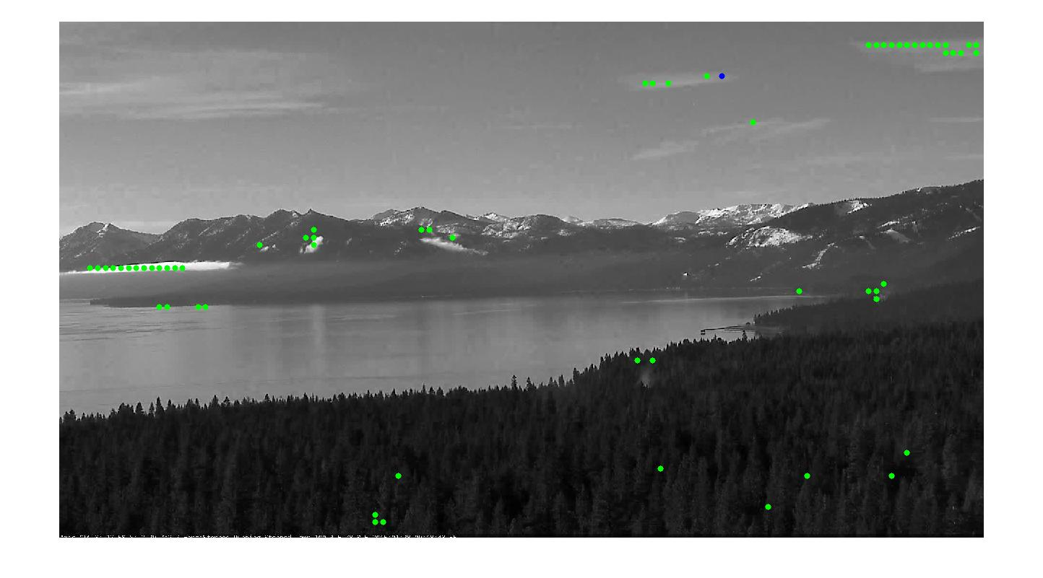
PCA Results:
PCA’s take at the first picture shown from the Tahoe dataset from a very early stage in two fires.

Slide 14
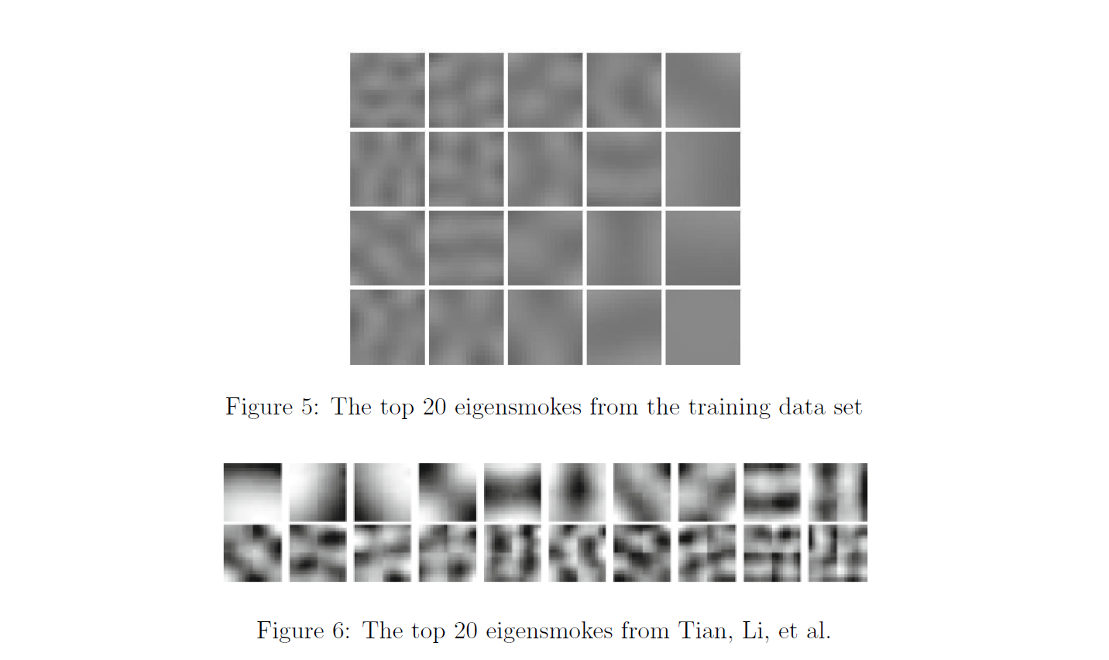
Eigensmokes:

Slide 15
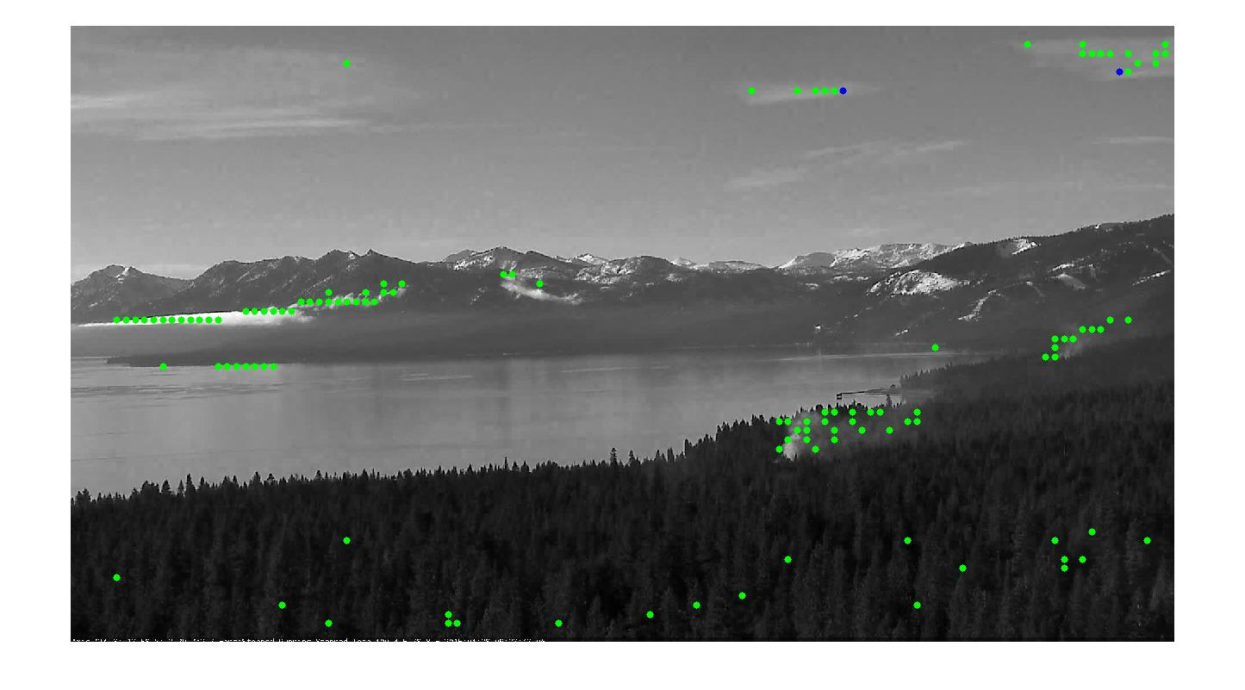
A picture from the Tahoe dataset from a later stage in the previous fire.

Slide 16
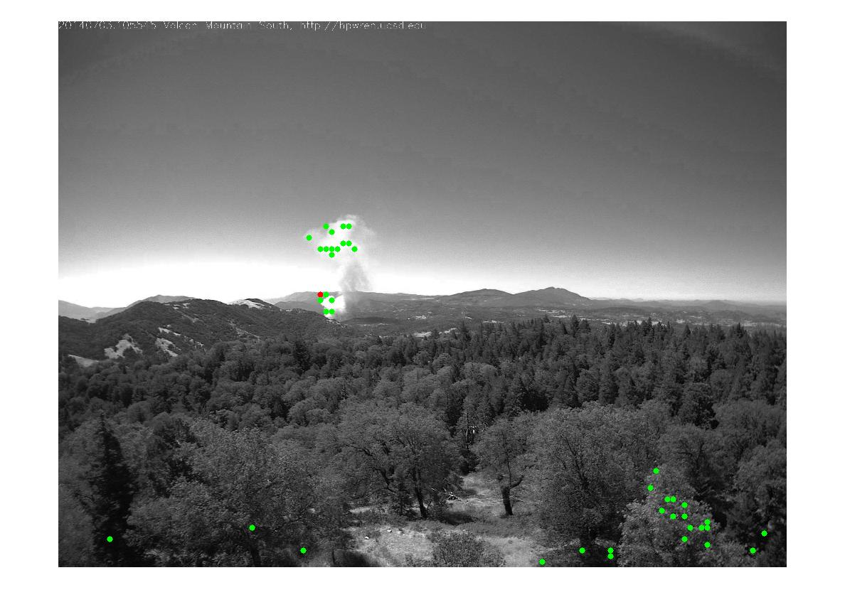
A picture from the southern California dataset classified with PCA on a clear day with an obvious fire.

Slide 17
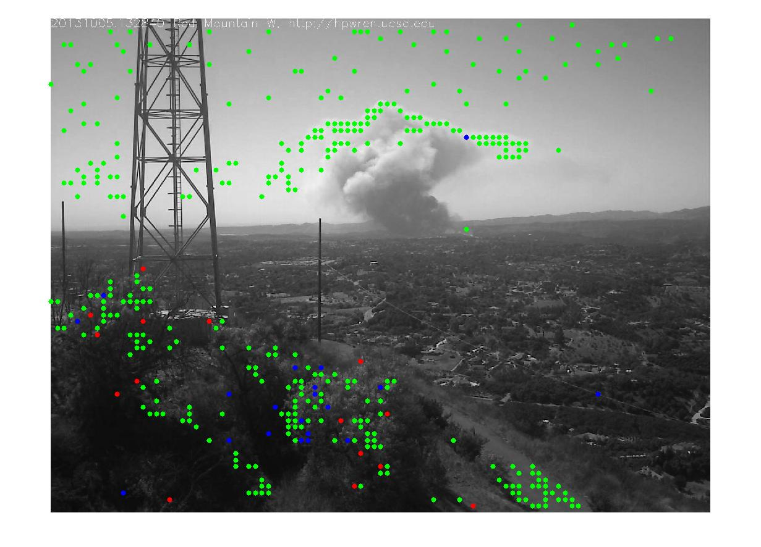
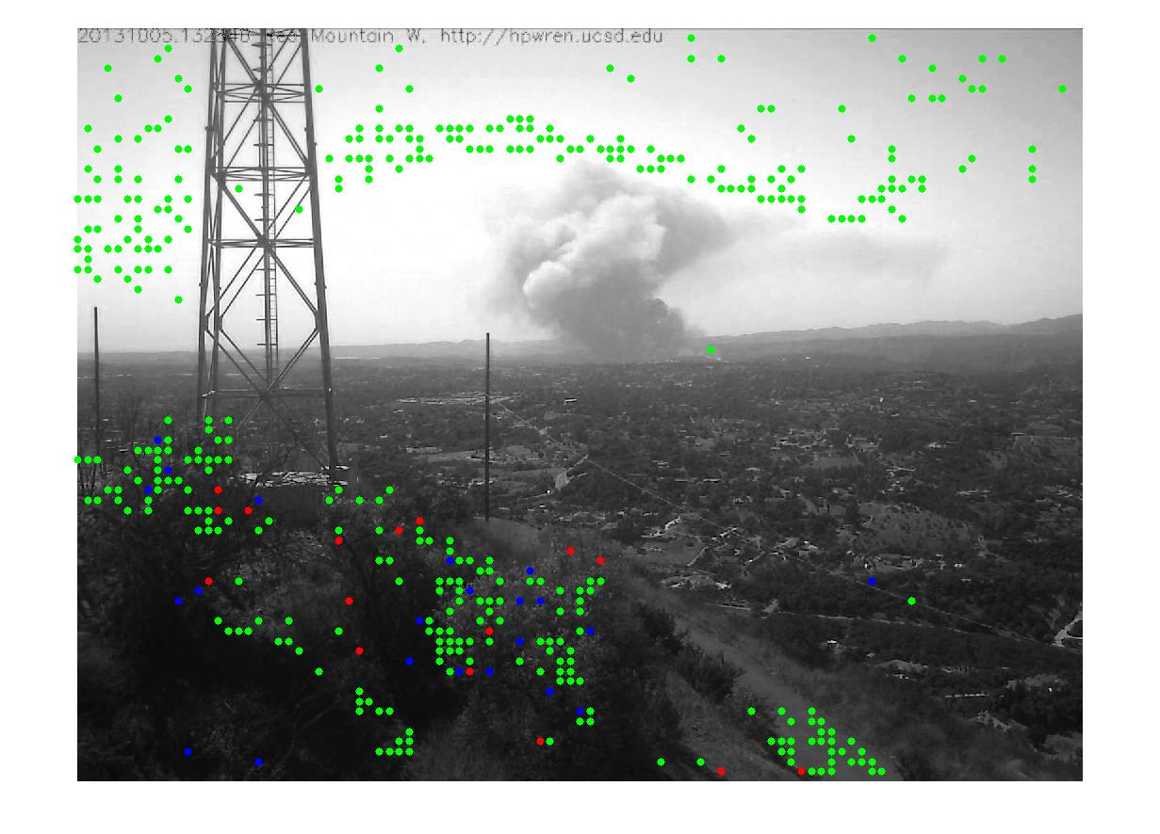
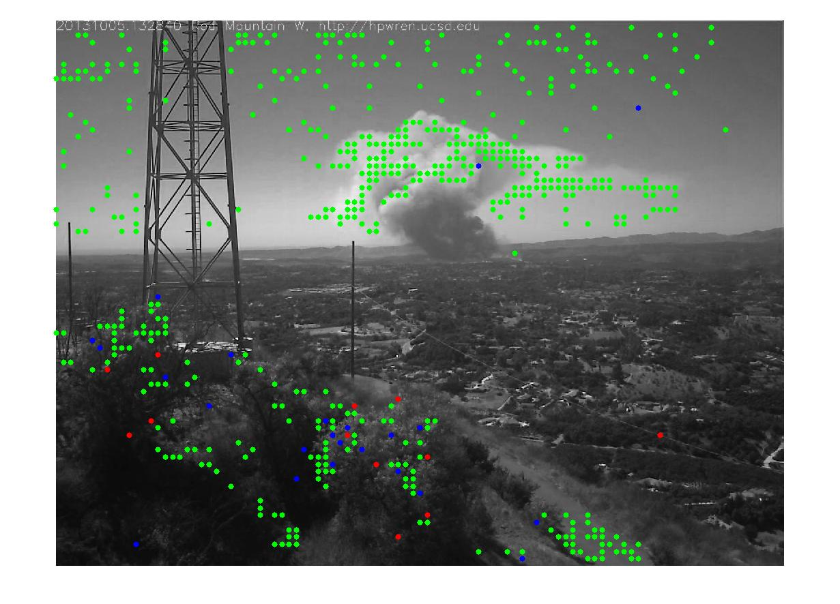
RGB Comparison:
Channel Comparison :
Blue Green Red

Slide 18
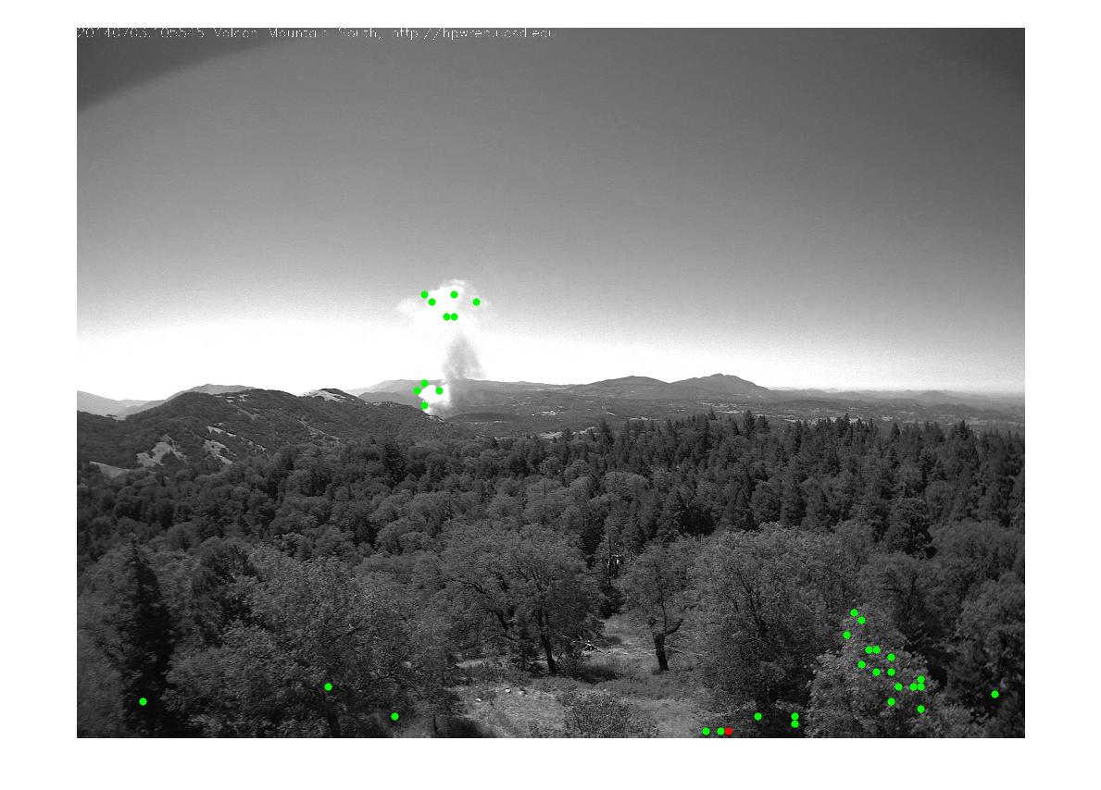
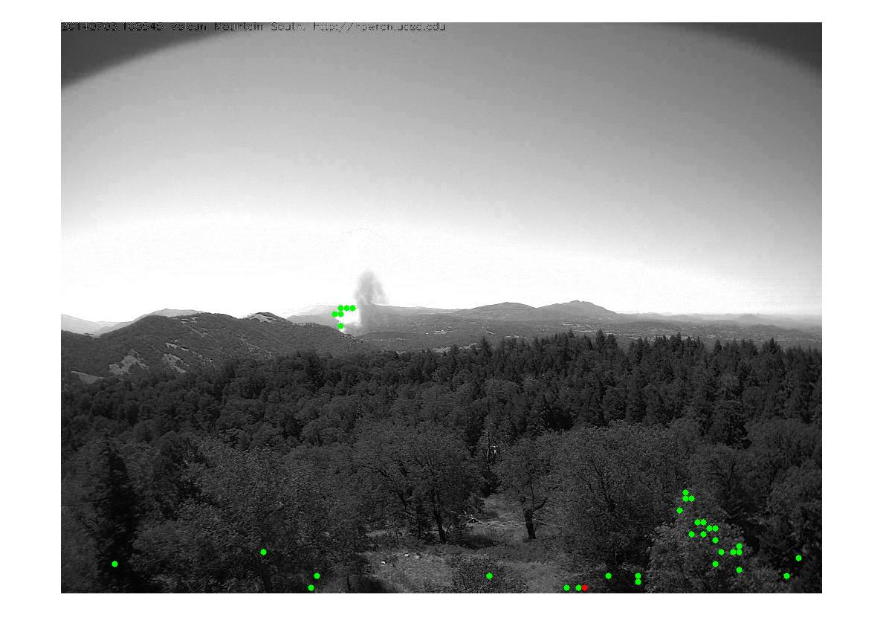
More Channel Comparison :
Blue Green Red

Slide 19
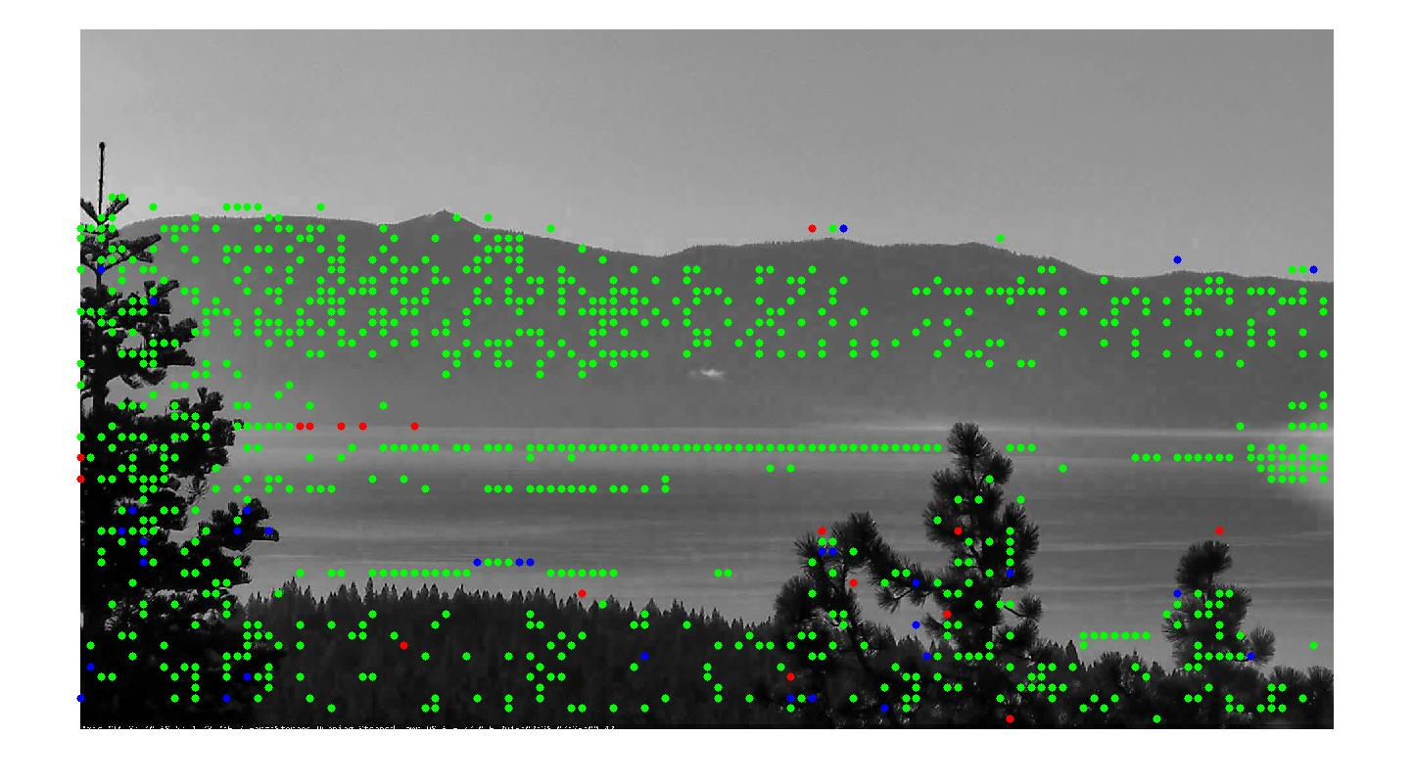
One False Positive in a Foggy Picture:

Slide 20
Thoughts on Results:
Local Smoothness never resulted in false positives, but generated a massive amount of false negatives.
PCA generally performs better, outputting many less false negatives. But in the case of heavy fog or low hanging clouds it can generate false positives, due to our eigensmokes being quite structurally similar to clouds.

Slide 21
Useful and Extendable:
Due to the infrequent occurrence of false positives, these two methods greatly reduce the amount of regions the classifier must examine, hopefully allowing for early fire detection.
This work can be made modular and edited to be incorporated into the final ensemble.

Slide 22
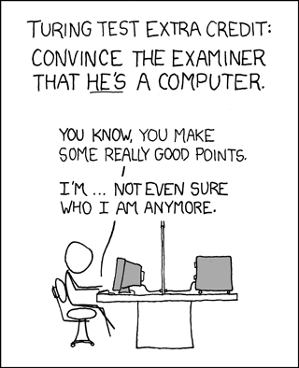
Now on to bigger and better things!
We’d like to greatly thank Dr. Rojas for the amazing and informative semester.
As well as Tian, Li et al for the methodology and smoke data used here.

Slide 23
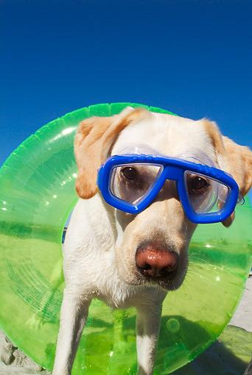
Hope you all have a great summer!

